Slide 1
Theory of Automata
CS09305
Lecture 13

Slide 2
Transition Graphs

Slide 3
Transition Graphs(TG)
Can read multiple characters before making a transition
Thus every edge can be labeled with a substring instead of a single character
Can have multiple start states

Slide 4
Transition Graphs
Examples
  All words that start and end with a double letter
a,b
aa,bb
-1
2
aa,bb
+3

Slide 5
 | DFA | NFA | TG
1 | Exactly one start state | Exactly one start state | Can have more the one start state
2 | One or more or may be no final state | One or more or may be no final state | One or more or may be no final state
3 | Only single character read on making transition | Only single character read on making transition | Can read multiple character on making transition
4 | No duplicate Edges | Has duplicate Edges | Has duplicate Edges
5 | No missing Edges | has missing Edges | has missing Edges
6 | No Null transition | Can have null transition | Can have null transition

Slide 6
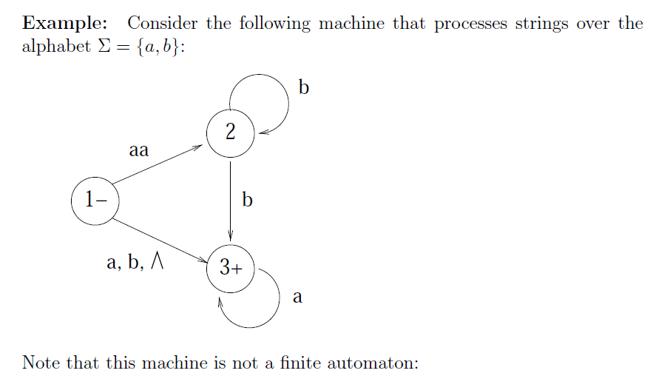
Examples

Slide 7
The arc from state 1 to state 2 is labeled with the string aa, which is not a single letter.
There are two arcs leaving state 2 labeled with b.
There is no arc leaving state 2 labeled with a.
There is an arc from state 1 to state 3 labeled with , which is not a letter from .
There is no arc leaving state 3 labeled with b.

Slide 8
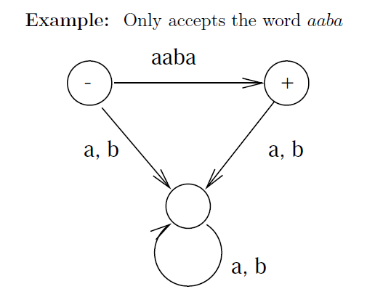

Slide 9
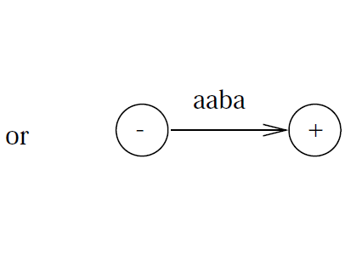

Slide 10
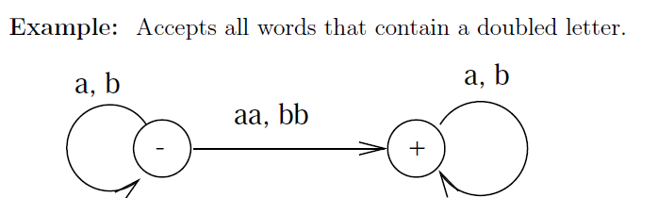

Slide 11
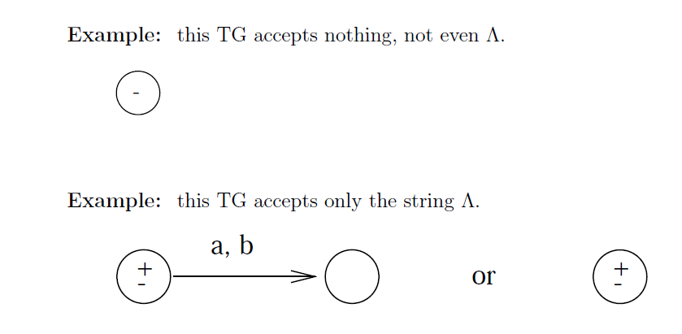

Slide 12
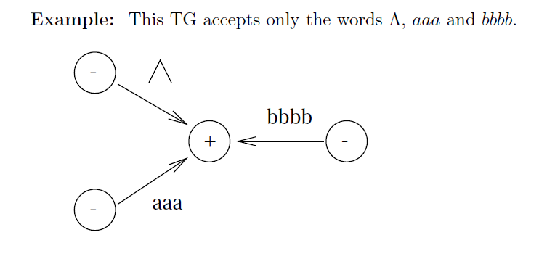

Slide 13
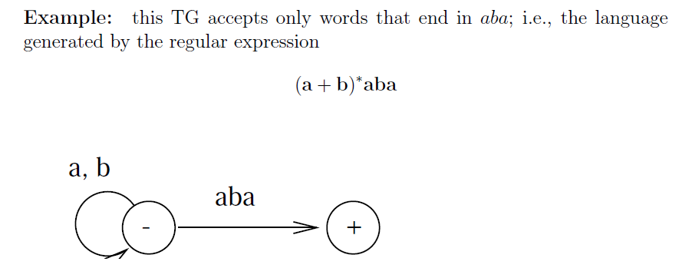

Slide 14
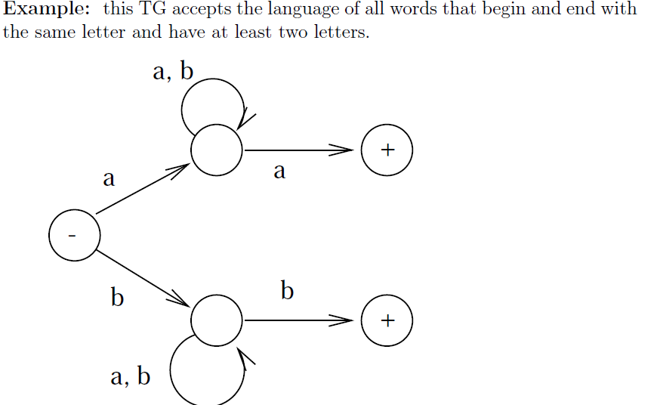

Slide 15
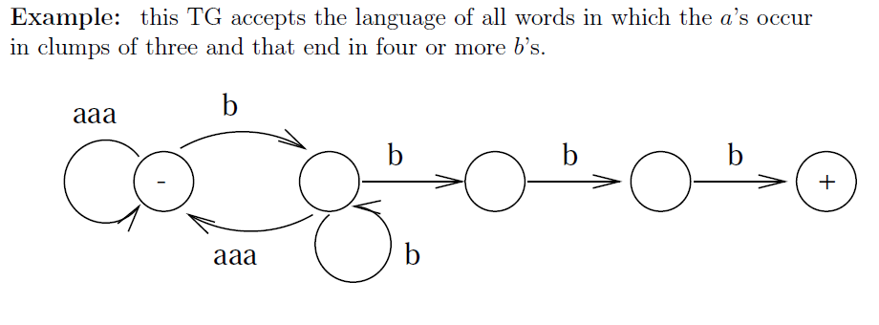

Slide 16
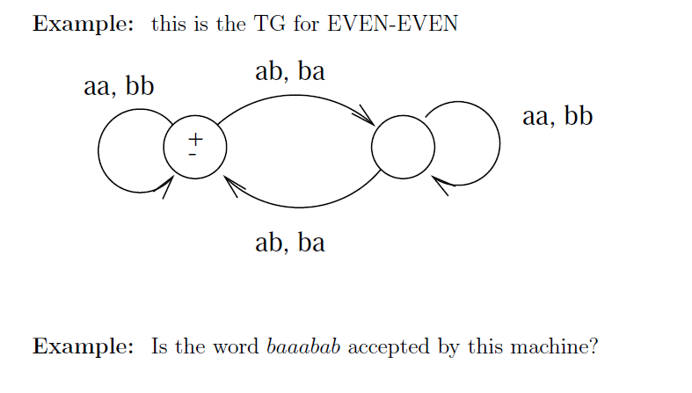

Slide 17
Transition Graphs
Examples
  All words that have al least one double letter in them
  All words that begin and end with different letters
  All words in which a occurs only in even clumps and that end in three or more bs
  All words that have even number of letters

Slide 18
Generalized Transition Graphs
A variation of TG
A generalized transition graph is a collection of three things
  A finite set of states, of which at least one is a start state and some (may be none) are final states
  An alphabet ∑ of input letters
  Directed edges connecting some pairs of states each labeled with a regular expression

Slide 19
Generalized Transition Graphs
a*
a*
-1
(ba +a)*
2
( Λ)
3 +
This machine accepts all strings without a double b

Slide 20
GTGs
Examples
  All words having even number of as and bs
  All words that start with ab
  All words having as in clumps of even numbers and end at one or more bs

